Slide 1
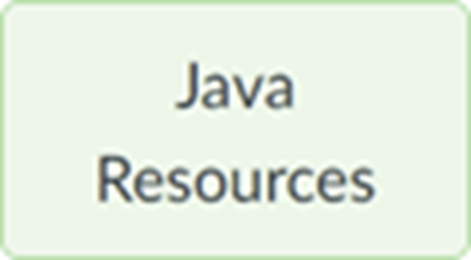
Section 07 (week of Oct 16) : Advanced Java part 6
We'll start at 5:01 (Tuesday) and 7:16 (Wednesday) Eastern Time.
Pset 3 is due at start of the lecture 8 week at 9am. See the Notes.
You MUST review the midterm rules and take the Proctorio setup quiz
Your questions
Processing sequential pairs of inputs
Creating your own exceptions
DataInputStream and DataOutputStream
ArrayLists
Text File Input (the old-fashioned way)
Zip file with this section’s slides and sample code is posted to course’s page

Slide 2
Processing sequential pairs of inputs
A common requirement (e.g. NoDuplicates.java)
Process N inputs (e.g. input₁, input₂, input₃, input₄) as they are read
Read input₁.
Read input₂. After reading input₂, process input₁ and input₂
Read input₃. After reading input₃, process input₂ and input₃
Read input₄. After reading input₄, process input₃ and input₄
Notes:
Let’s write a program to do this. We’ll end up with ProcessingSequentialPairsOfInputs.java
How many input values are we simultaneously working with?
So how many variables do we need to store input values?

Slide 3
Processing sequential pairs of inputs
A common requirement (e.g. Increase.java, Matryoshka.java)
Process N inputs (e.g. input₁, input₂, input₃, input₄) as they are read
Read input₁.
Read input₂. After reading input₂, process input₁ and input₂
Read input₃. After reading input₃, process input₂ and input₃
Read input₄. After reading input₄, process input₃ and input₄
Read input₁
Read input₂
Process input₁ and input₂
Read input₃
Process input₂ and input₃
Read input₄
Process input₃ and input₄
Notes:
Suppose n==4. Maybe seeing it like this will help us to structure our code.
Which boxes look like they’ll be in a loop?
If we are dealing with a total of n inputs, how often does the loop iterate?
Since we know how often the loop iterates, what kind of loop should it be?
Q: Where do we read input₁? A: before the loop.

Slide 4
Creating Your Own Exceptions
Unchecked Exception
Create a class that extends RuntimeException
Checked Exception
Create a class that extends Exception
Include 0-arg and 1-arg constructors
public class myCustomException extends ... { public myCustomException() { super(); } public myCustomException( String s ) { super( s ); } }
See Animal.java, IllegalAnimalAgeException.java, AnimalTest.java

Slide 5
DataInputStream and DataOutputStream
For reading and writing binary data
Benefits:
Binary data takes less space than the text equivalent.
You avoid ascii ↔ binary conversions.
Drawbacks:
Binary data is visually incomprehensible in text editors.
See DataStreamDemo.java

Slide 6
ArrayLists
Array’s shortcomings:
Hard to resize
Hard to insert and delete elements
ArrayList’s benefits
Automatic resizing
Efficient to insert and delete elements
ArrayList is a generic class
ArrayList<MyCustomDataRecord> arrayList = new ArrayList<MyCustomDataRecord>();
See ArrayListDemo.java, ArrayListsAsArguments.java

Slide 7
Text File Input (the old-fashioned way)
You might encounter these classes that were used for IO in "the old days"
BufferedReader br = new BufferedReader( new InputStreamReader( new FileInputStream( "pathToFile" ) ) );
FileInputStream reads 8-bit bytes
InputStreamReader reads multi-byte unicode characters
BufferedReader buffers characters for efficiency

